Slide 1
MIDDLETON CHENEY
FOOT BALL CLUB

Slide 2
“A” TEAM
1983-84
SEASON
LORD JERSEY
FOOTBALL LEAGUE
DIVISION III
AND CUPS

Slide 3
MIDDLETON CHENEY
1st Team Manager Dick Ashburn & Alan Coleman
Res Team Manager Pete Allington
A. Team Manager Jeff Sargent & Ian Wickens
1st Team Banbury Premier League
Res Team Lord Jersey League Division II
A Team Lord Jersey League Division III

Slide 4
September 6th 1983 Lord Jersey Div III - Away
Bicester Civil Service Res 1 v 1 Middleton “A”
A. Coleman
M. Lee
J. Sargent
M. Ashburn
T. King
Dar Gascoigne Goal Scorers J. Sargent
P. Holland
P. Ashburn
S. Harris
M. Twynham
N. Davidson
Sub-
Sub-

Slide 5
September 10th 1983 Lord Jersey Div III - Home
Middleton “A” 2 v 0 Heyford Ath Res
T. King
M. Lee
J. Sargent
D. Jeacock
M. Walton
Dar Gascoigne Goal Scorers S. Harris
P. Holland I. Croft
A. Garrett
S. Harris
I. Croft
N. Davidson
Sub-
Sub-

Slide 6
September 17th 1983 Lord Jersey Div III - Away
Charlton Utd Res 1 v 0 Middleton “A”
T. King
M. Lee
J. Sargent
M. Ashburn
P. Ashburn
Dar Gascoigne Goal Scorers
P. Holland
A. Ashton
S. Harris
D. Johnson
N. Davidson
Sub- S. Wilkes
Sub-

Slide 7
September 24th 1983 Lord Jersey Div III - Home
Middleton “A” 2 v 1 Middle Barton
T. King
M. Lee
M. Ashburn
J. Sargent
D. Jeacock
P. Ashburn Goal Scorers N. Davidson 2
P. Holland
C. Wait
S. Harris
P. Wilkins
N. Davidson
Sub- D. Johnson
Sub-

Slide 8
October 1st 1983 Lord Jersey Div III - Home
Middleton “A” 1 v 1 Kirtlington Res
M. Twynham
M. Lee
M. Ashburn
J. Sargent
D. Jeacock
N. Johnson Goal Scorers A. Garrett
P. Holland
A. Garrett
S. Harris
P. Wilkins
N. Davidson
Sub- P. Ashburn
Sub-

Slide 9
October 8th 1983 Lord Jersey Div III - Away
Courtyard Rovers 4 v 1 Middleton “A”
M. Twynham
P. Hawkes
M. Ashburn
J. Sargent
D. Jeacock
N. Johnson Goal Scorers C. Wait
P. Holland
P. Ashburn
P. Wilkins
C. Wait
A. Garrett
Sub- S. Harris
Sub-

Slide 10
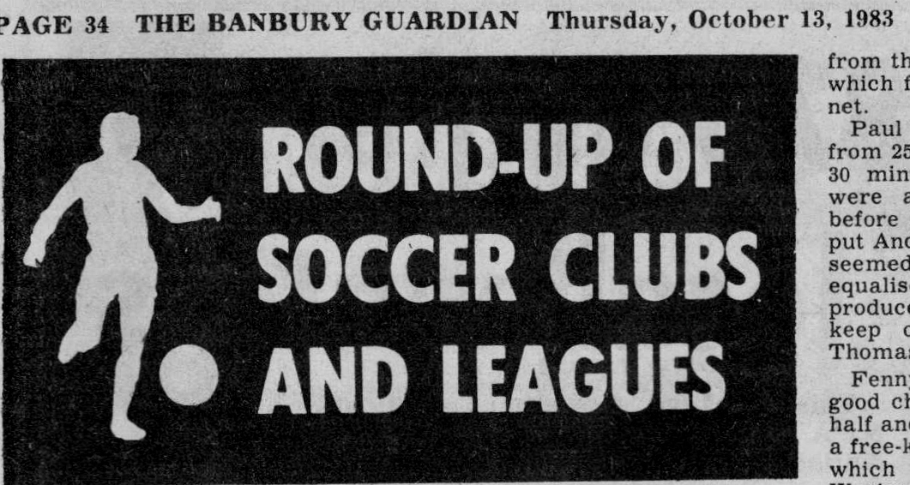
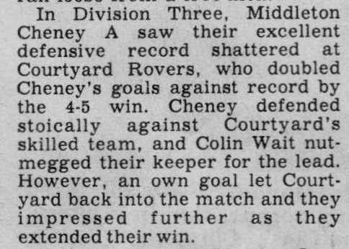

Slide 11
October 15th 1983 Lord Jersey Div III - Away
Merton Res 1 v 3 Middleton “A”
P. Wilkins
P. Hawkes
D. Johnson
J. Sargent
D. Jeacock
P. Ashburn Goal Scorers A. White 2
P. Holland C. Wait
C. Wait
N. Davidson
A. White
A. Garrett
Sub- Dar Gascoigne
Sub-

Slide 12
October 29th 1983 Lord Jersey Div III - Away
Horse & Groom 1 v 3 Middleton “A”
M. Twynham
P. Ashburn
J. Sargent
D. Jeacock
D. Johnson
C. Wait Goal Scorers C. Wait 2
Dar Gascoigne P. Hawkes
A. Ashton
N. Davidson
P. Hawkes
A. Garrett
Sub- S. Wright
Sub-

Slide 13
November 5th 1983 Lord Jersey Div III - Home
Middleton “A” 3 v 3 King Sutton
M. Twynham
M. Lee
J. Sargent
D. Jeacock
P. Ashburn
Dar Gascoigne Goal Scorers P. Wilkins 2
C. Wait P. Hawkes
P. Wilkins
S. Harris
P. Hawkes
A. Garrett
Sub- A. Ashton
Sub-

Slide 14
November 12th 1983 Lord Jersey Supp Cup - Home
Middleton “A” 5 v 2 Heyford Ath Res
M. Twynham
D. Johnson
D. Jeacock
J. Sargent
P. Ashburn
A. Ashton Goal Scorers P. Wilkins 2
C. Wait P. Hawkes 2
A. Garrett S. Harris
S. Harris
P. Wilkins
P. Hawkes
Sub-
Sub-

Slide 15
November 19th 1983 Lord Jersey Div III – Away (Played at Middleton)
King Sutton 3 v 2 Middleton “A”
M. Garrett
D. Johnson
J. Sargent
C. Wait
P. Ashburn
A. Garrett Goal Scorers C. Wait
A. Wheatley P. Hawkes
A. Ashton
S. Harris
P. Wilkins
P. Hawkes
Sub- N. Davidson
Sub-

Slide 16
November 26th 1983 Lord Jersey Div III - Home
Middleton “A” 4 v 1 Charlton Res
M. Garrett
P. Hawkes
J. Sargent
D. Jeacock
D. Johnson
A. Ashton Goal Scorers C. Wait
C. Wait P. Wilkins
Pete Gwynne A. Wheatley
S. Harris S. Harris
P. Wilkins
A. Wheatley
Sub- N. Davidson
Sub-

Slide 17
December 3rd 1983 Lord Jersey Div III - Home
Middleton “A” 4 v 1 Weston
A. Coleman
M. Twynham
J. Sargent
D. Jeacock
D. Johnson
A. Ashton Goal Scorers N. Davidson 2
C. Wait A. Garrett
P. Hawkes S. Harris
S. Harris
A. Garrett
A. Wheatley
Sub- N. Davidson
Sub-

Slide 18
December 10th 1983 Lord Jersey Div III - Away
Middle Barton 0 v 0 Middleton “A”
M. Twynham
P. Hawkes
D. Jeacock
J. Sargent
D. Johnson
A. Ashton Goal Scorers
R. Northover
C. Wait
N. Davidson
A. Garrett
S. Harris
Sub-
Sub-

Slide 19
December 17th 1983 Lord Jersey Supp Cup - Away
Kirtlinton Res 2 v 3 Middleton “A”
M. Twynham
P. Hawkes
J. Sargent
D. Jeacock
D. Johnson
P. Ashburn Goal Scorers J. Sargent
C. Wait A. Garrett
Paul Gwynne N. Davidson
N. Davidson
P. Wilkins
A. Garrett
Sub- A. Wilkins
Sub-

Slide 20
December 31st 1983 Lord Jersey Supp Cup - Home
Middleton “A” 3 v 1 Weston
M. Twynham
D. Johnson
J. Sargent
D. Jeacock
P. Ashburn
A. Ashton Goal Scorers C. Wait
C. Wait A. Ashton
A. Wilkins P. Hawkes
N. Davidson
P. Hawkes
A. Garrett
Sub- R. Northover
Sub-

Slide 21
January 7th 1984 Lord Jersey Div III - Away
Kirtlington Res 0 v 2 Middleton “A”
A. Coleman
M. Twynham
J. Sargent
A. Wilkins
D. Jeacock
P. Ashburn Goal Scorers P. Hawkes
C. Wait N. Davidson
R. Northover
A. Ashton
P. Hawkes
N. Davidson
Sub- I. Croft
Sub-

Slide 22
January 14th 1984 Lord Jersey Supp Cup - Away
King Sutton Res 2 v 9 Middleton “A”
A. Coleman
M. Twynham
D. Jeacock
J. Sargent
P. Ashburn
R. Northover Goal Scorers P. Hawkes 3
C. Wait A. Wheatley 2
A. Ashton N. Davidson 2
P. Hawkes C. Wait
A. Wheatley Own goal
N. Davidson
Sub- D. Johnson
Sub-

Slide 23
January 21st 1984 Lord Jersey Supp Cup - Away
Heyford Ath Res 0 v 6 Middleton “A”
A. Coleman
M. Twynham
D. Jeacock
J. Sargent
P. Ashburn
R. Northover Goal Scorers A. Wheatley 3
D. Laud P. Hawkes
A. Ashton R. Northover
P. Hawkes D. Laud
A. Wheatley
N. Davidson
Sub- D. Johnson
Sub-

Slide 24
January 28th 1984 Lord Jersey Mann Cup 1st Rd- Away
Merton Res 3 v 6 Middleton “A”
A. Coleman
M. Twynham
P. Ashburn
D. Jeacock
J. Sargent
R. Northover Goal Scorers A. Wheatley 3
P. Holland P. Hawkes 3
Pete Gwynne
D. Johnson
A. Wheatley
P. Hawkes
Sub- Dar Gascoigne
Sub-

Slide 25
February 4th 1984 Lord Jersey Supp Cup - Home
Middleton “A” 3 v 3 King Sutton Res
A. Coleman
M. Twynham
J. Sargent
D. Jeacock
P. Ashburn
R. Northover Goal Scorers R. Northover 2
P. Holland A. Wheatley
A. Ashton
P. Hawkes
A. Wheatley
M. Howes
Sub- C. Wait
Sub-

Slide 26
February 11th 1984 Lord Jersey Div III - Home
Middleton “A” 9 v 1 Horse & Groom
M. Twynham
D. Johnson
D. Jeacock
J. Sargent
P. Ashburn
R. Northover Goal Scorers A. Wheatley 3
P. Holland C. Farrow 2
A. Ashton P. Hawkes 2
P. Hawkes P. Holland
C. Farrow J. Sargent
A. Wheatley
Sub- C. Wait
Sub-

Slide 27
February 18th 1984 Lord Jersey Supp Cup - Away
Piddington Res 0 v 7 Middleton “A”
M. Twynham
M. Ashburn
J. Sargent
D. Jeacock
I. Walters
A. Ashton Goal Scorers M. Howes 3
P. Holland Paul Gwynne 2
C. Wait P. Hawkes 2
P. Hawkes
Paul Gwynne
M. Howes
Sub- D. Johnson
Sub-

Slide 28
February 25th 1984 Lord Jersey Div III - Home
Middleton “A” 4 v 2 Piddington Res
M. Twynham
M. Ashburn
D. Jeacock
J. Sargent
I. Walters
A. Ashton Goal Scorers A. Garrett 2
P. Holland M. Howes
C. Wait C. Wait
P. Hawkes
A. Garrett
M. Howes
Sub- M. Lee
Sub-

Slide 29
March 3rd 1984 Lord Jersey Mann Cup Semi Final - Home
Middleton “A” 1 v 1 Bicester Civil Service Res
M. Twynham
P. Ashburn
M. Howes
J. Sargent
D. Jeacock
R. Northover Goal Scorers P. Hawkes
P. Holland
A. Ashton
P. Hawkes
C. Wait
P. Wilkins
Sub- N. Davidson
Sub-

Slide 30
March 10th 1984 Lord Jersey Mann Cup Semi Final Replay - Away
Bicester Civil Service Res 6 v 5 Middleton “A”
M. Garrett
P. Ashburn
J. Sargent
D. Jeacock
M. Twynham
Dar Gascoigne Goal Scorers M. Howes 2
P. Holland P. Hawkes 2
A. Ashton P. Wilkins
P. Hawkes
P. Wilkins
M. Howes
Sub-
Sub-

Slide 31
March 24th 1984 Lord Jersey Div III - Away
Heyford Ath Res 2 v 3 Middleton “A”
M. Garrett
P. Ashburn
J. Sargent
S. Wilkes
C. Wait
A. Garrett Goal Scorers P. Wilkins
P. Holland N. Davidson
P. Wilkins C. Wait
N. Davidson
D. Johnson
Pete Gwynne
Sub- D. Wait
Sub-

Slide 32
March 31st 1984 Lord Jersey Div III - Home
Middleton “A” 8 v 2 Merton Res
M. Garrett
M. Twynham
D. Jeacock
J. Sargent
A. Garrett
Pete Gwynne Goal Scorers P. Hawkes 4
P. Holland N. Berry 3
C. Wait P. Wilkins
P. Hawkes
P. Wilkins
N. Berry
Sub- N. Davidson
Sub-

Slide 33
April 4th 1984 Lord Jersey Supp Cup - Home
Middleton “A” 5 v 1 Kirtlington Res
M. Garrett
M. Twynham
D. Jeacock
J. Sargent
P. Ashburn
C. Wait Goal Scorers P. Hawkes 2
P. Holland N. Berry 2
A. Garrett C. Wait
P. Hawkes
P. Wilkins
N. Berry
Sub- D. Johnson
Sub-

Slide 34
April 7th 1984 Lord Jersey Supp Cup - Away
Weston 1 v 2 Middleton “A”
M. Garrett
M. Twynham
J. Sargent
D. Jeacock
P. Ashburn
C. Wait Goal Scorers P. Hawkes
P. Holland A. Garrett
P. Wilkins
P. Hawkes
A. Garret
N. Berry
Sub-
Sub-

Slide 35
April 14th 1984 Lord Jersey Supp Cup - Home
Middleton “A” 5 v 2 Piddington Res
M. Garrett
M. Twynham
S. Wilkes
J. Sargent
D. Jeacock
C. Wait Goal Scorers P. Hawkes 5
P. Holland
A. Ashton
P. Wilkins
P. Hawkes
Paul Gwynne
Sub- Dar Gascoigne
Sub-

Slide 36
April 25th 1984 Lord Jersey Div III - Home
Middleton “A” 5 v 2 Courtyard Rovers
M. Garrett
A. Ashton
J. Sargent
J. Boyles
M. Twynham
C. Wait Goal Scorers P. Hawkes 3
I. Braggins J. Boyles
P. Wilkins P. Wilkins
M. Howes
P. Hawkes
A. Wheatley
Sub- N. Berry
Sub-

Slide 37
April 28th 1984 Lord Jersey Div III - Home
Middleton “A” 2 v 3 Bicester Civil Service Res
M. Garrett
J. Sargent Booked
J. Boyles
D. Jeacock
M. Twynham
A. Ashton Goal Scorers P. Hawkes
I. Braggins P. Wilkins
P. Wilkins
M. Howes
P. Hawkes
Pete Gwynne
Sub- P. Holland
Sub-

Slide 38
May 5th 1984 Lord Jersey Div III - Away
Weston 2 v 3 Middleton “A”
M. Garrett
P. Ashburn
S. Wilkes
J. Sargent
N. Clarke
A. Ashton Goal Scorers P. Hawkes 2
C. Wait C. Wait
Pete Gwynne
M. Howes
P. Hawkes
K. Pearson
Sub-
Sub-

Slide 39
May 19th 1984 Lord Jersey Supp Cup Final Played at Fritwell
Middleton “A” 3 v 3 Charlton Res
M. Garrett
A. Wilkins
J. Sargent
D. Jeacock
P. Ashburn
A. Ashton Goal Scorers A. Wheatley 2
C. Wait P. Wilkins
P. Wilkins
M. Howes
P. Hawkes
A. Wheatley
Sub- P. Holland
Sub-

Slide 40
May 24th 1984 Lord Jersey Supp Cup Final Replay Played at Rodney House
Middleton “A” 2 v 4 Charlton Res
M. Garrett
A. Wilkins
J. Sargent
D. Jeacock
P. Ashburn
A. Ashton Goal Scorers A. Wheatley
C. Wait P. Wilkins
P. Wilkins
P. Holland
P. Hawkes
A. Wheatley
Sub- Pete Gwynne
Sub-

